Slide 1

E-State
FYP-II
Obaid Ismail (190892)
Muhammad Umar Akhtar (190924)
Aamir Yasin (190928)
Intro
Supervisor
Main
Supervised by:
Hafiz Muhammad
Ahsan Shehzad

Slide 2

E-State
Ghar se Ghar lo
Supervisor
E-commerce web application in which users can buy and sell real estate.
Web tool through which users can experience virtual tour.
Payment through Credit/Debit Card.
Intro
Main

Slide 3
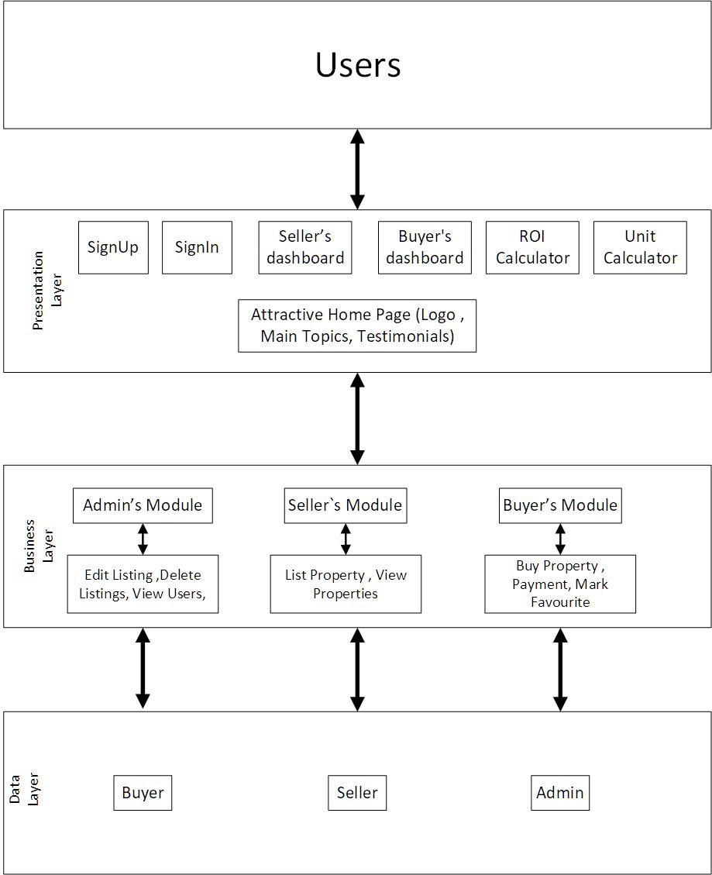

Architecture Diagram:
Supervisor
Intro
Main

Slide 4
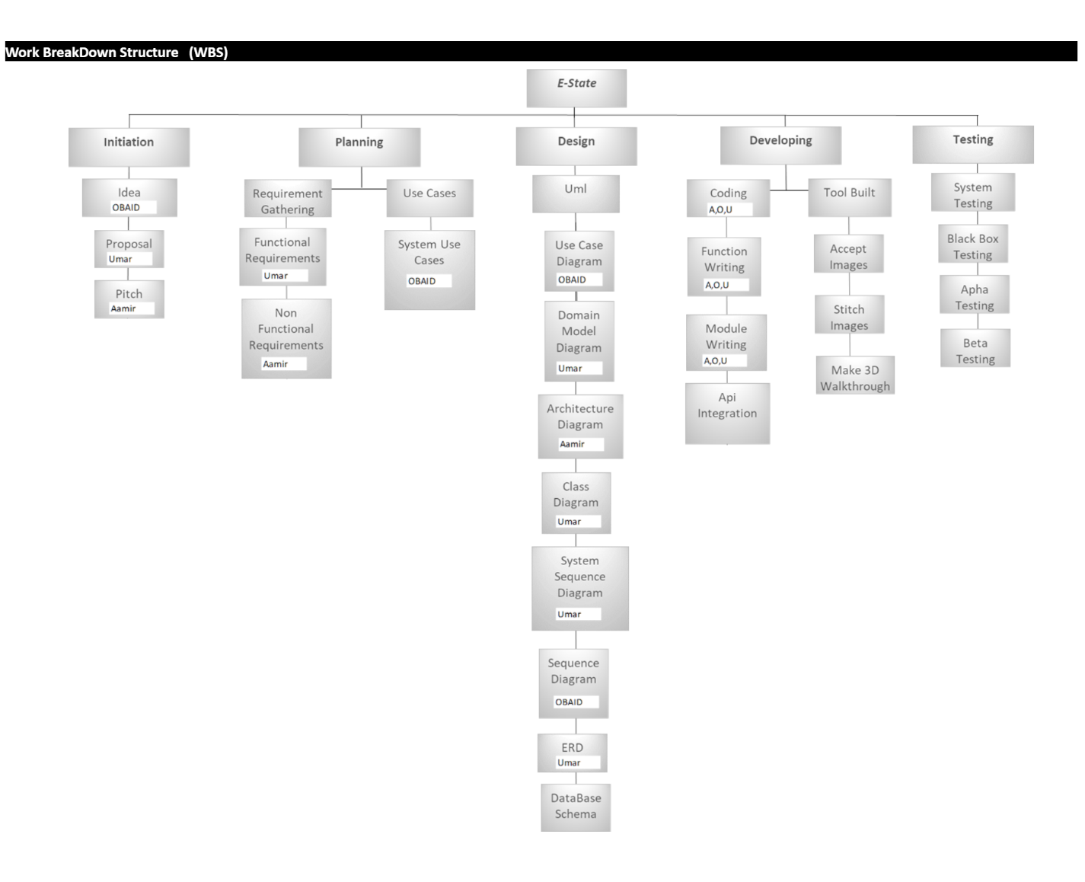
Project Work Break Down:
Supervisor
Intro
Main

Slide 5
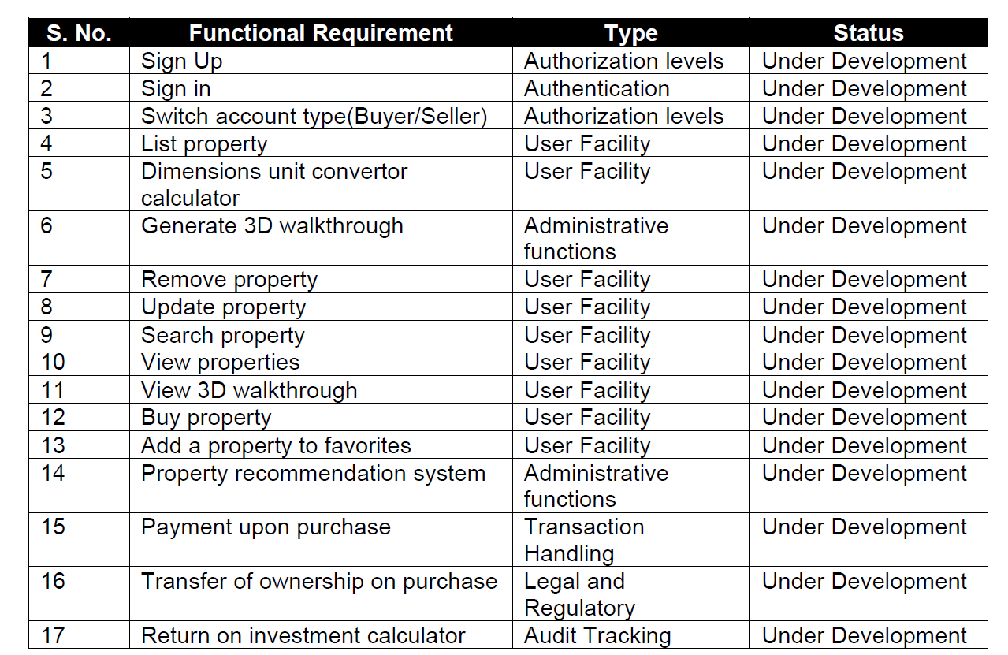
Functional Requirements:
teams
Supervisor
Intro
Main

Slide 6
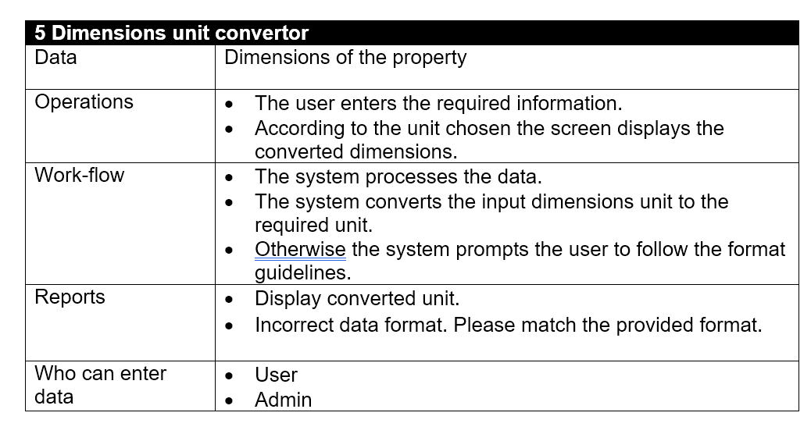
Functional Requirement:
Supervisor
Intro
Main

Slide 7
Use Case Diagram :
Supervisor
Intro
Main

Slide 8
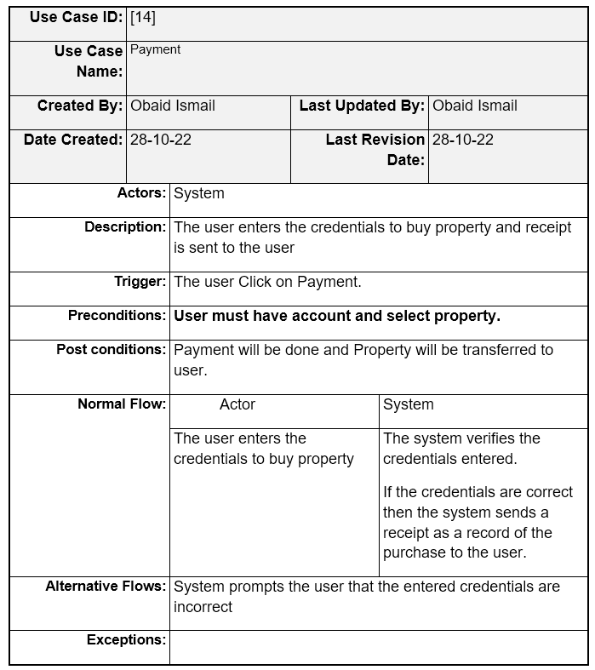
Fully Dressed
Use Case :
Supervisor
Intro
Main

Slide 9
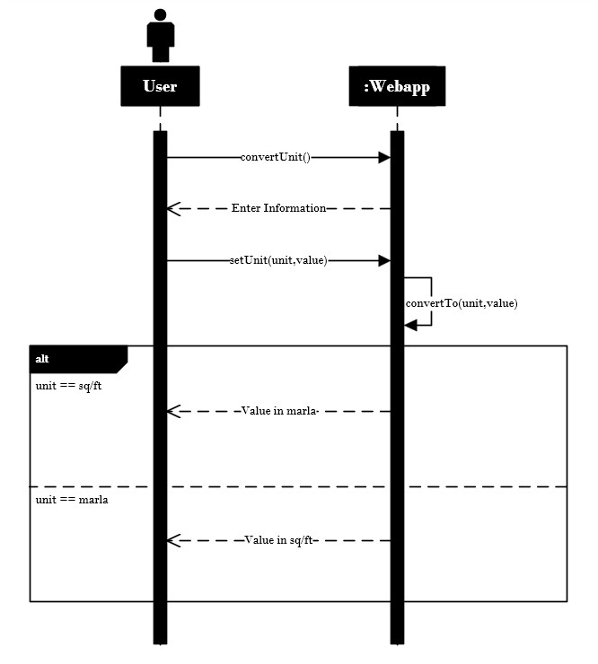
System Sequence
Diagram [5]:
Supervisor
Intro
Main

Slide 10
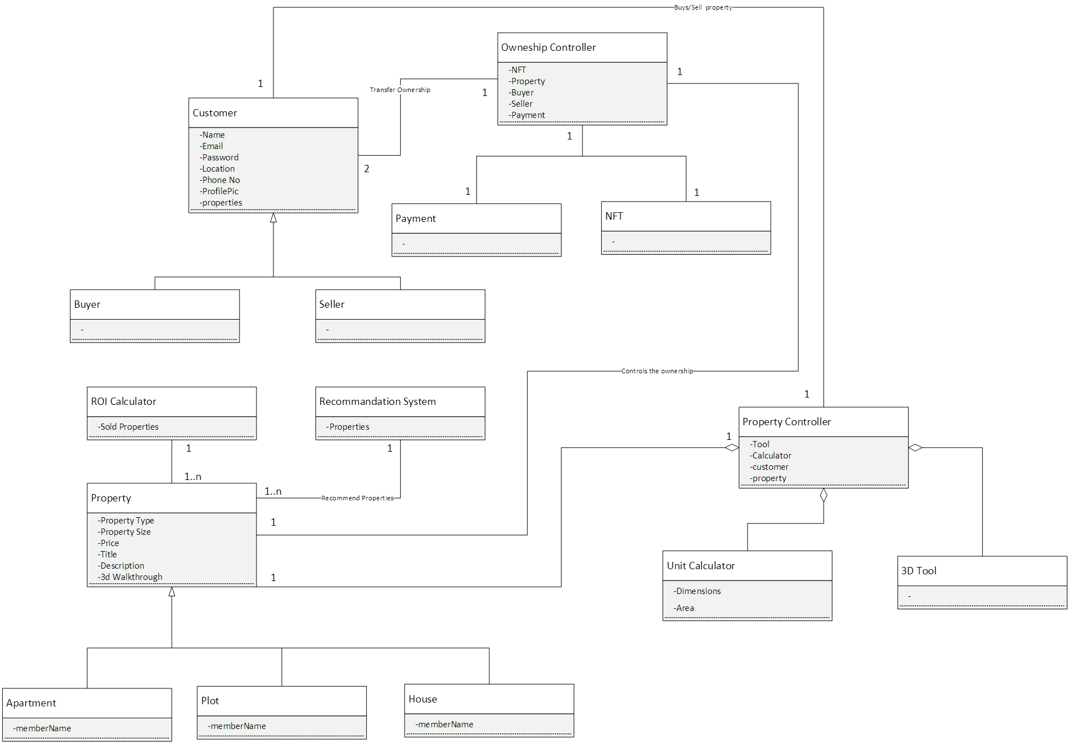
Domain Model:
Supervisor
Intro
Main

Slide 11
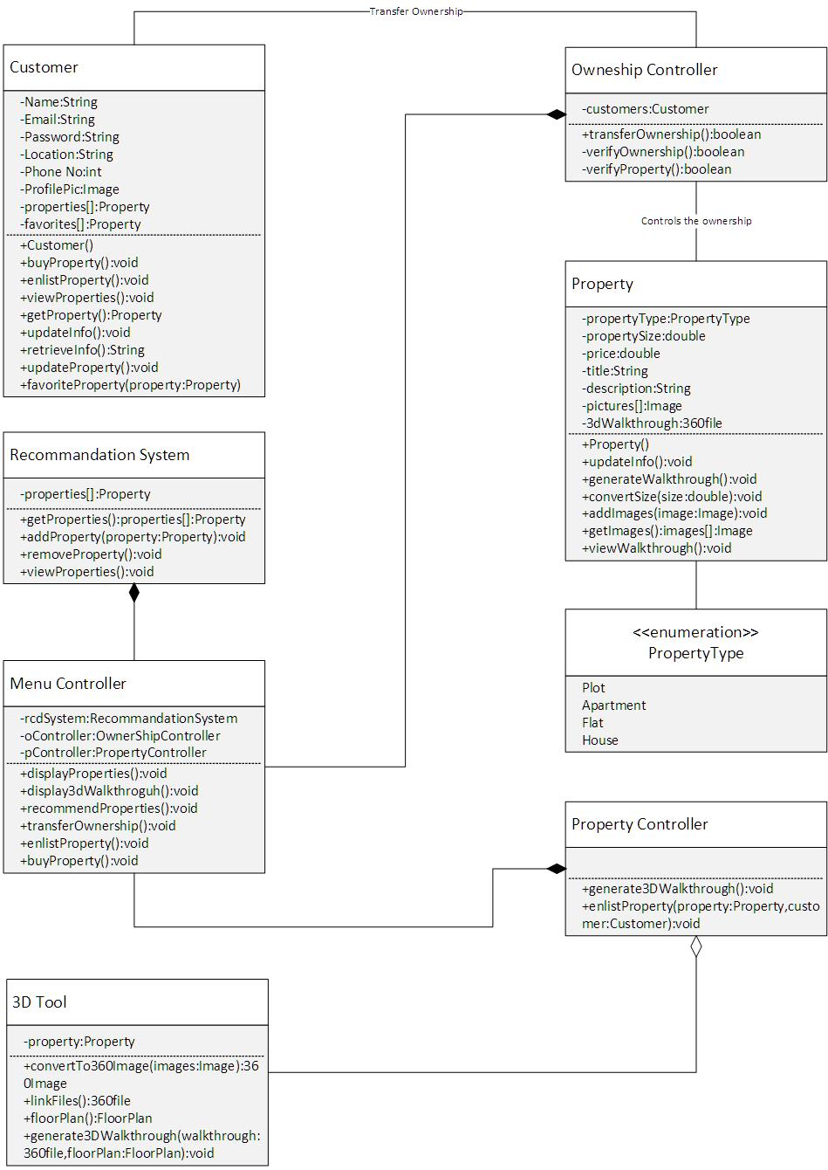
Class Diagram:
Supervisor
Intro
Main

Slide 12
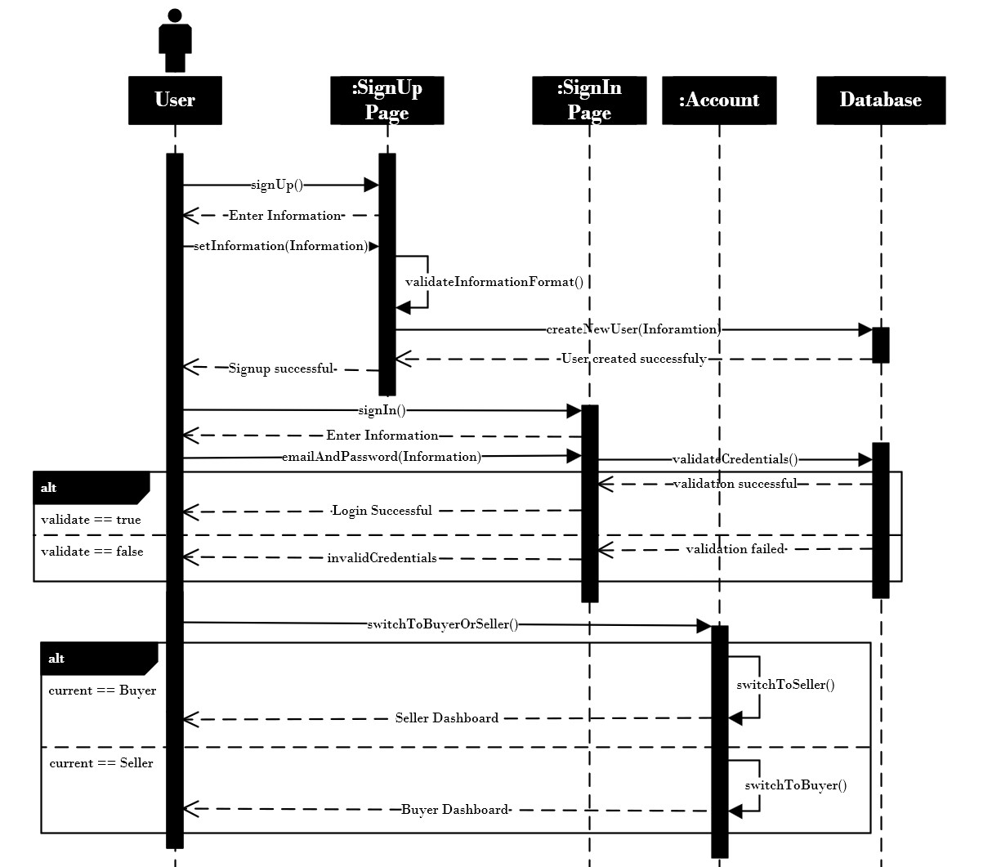
Sequence Diagram:
Supervisor
Intro
Main

Slide 13
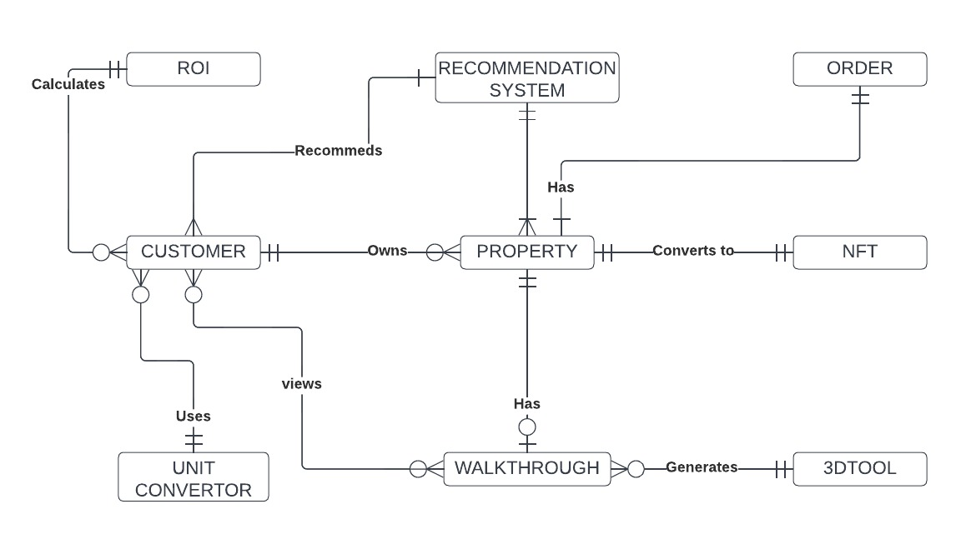
Entity Relationship Diagram:
Supervisor
Intro
Main

Slide 14
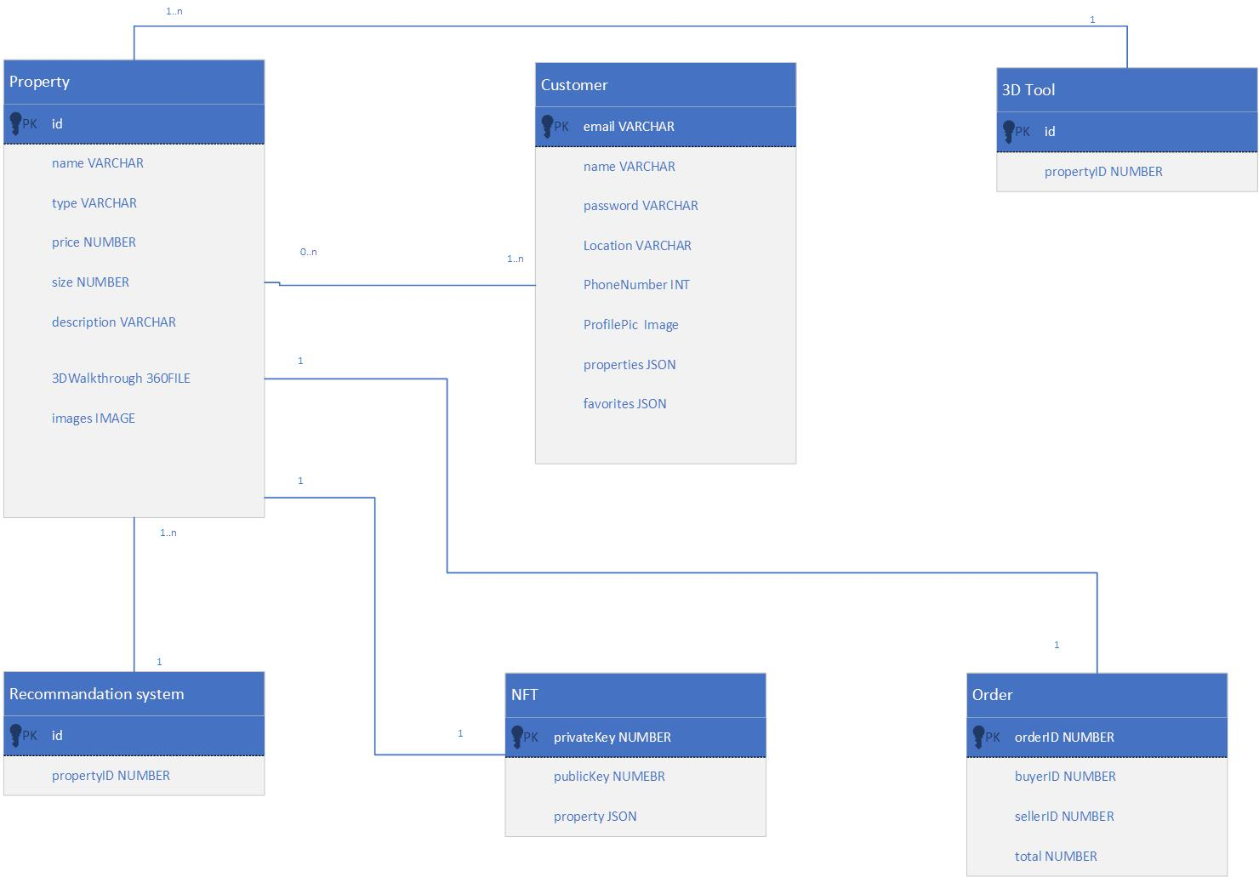
DataBase Schema:
Supervisor
Intro
Main

Slide 15
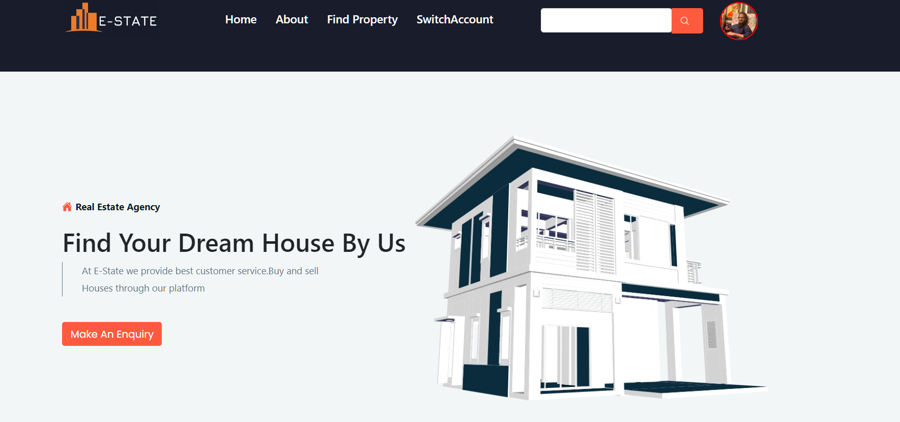
Home Page:
Supervisor
Intro
Main

Slide 16
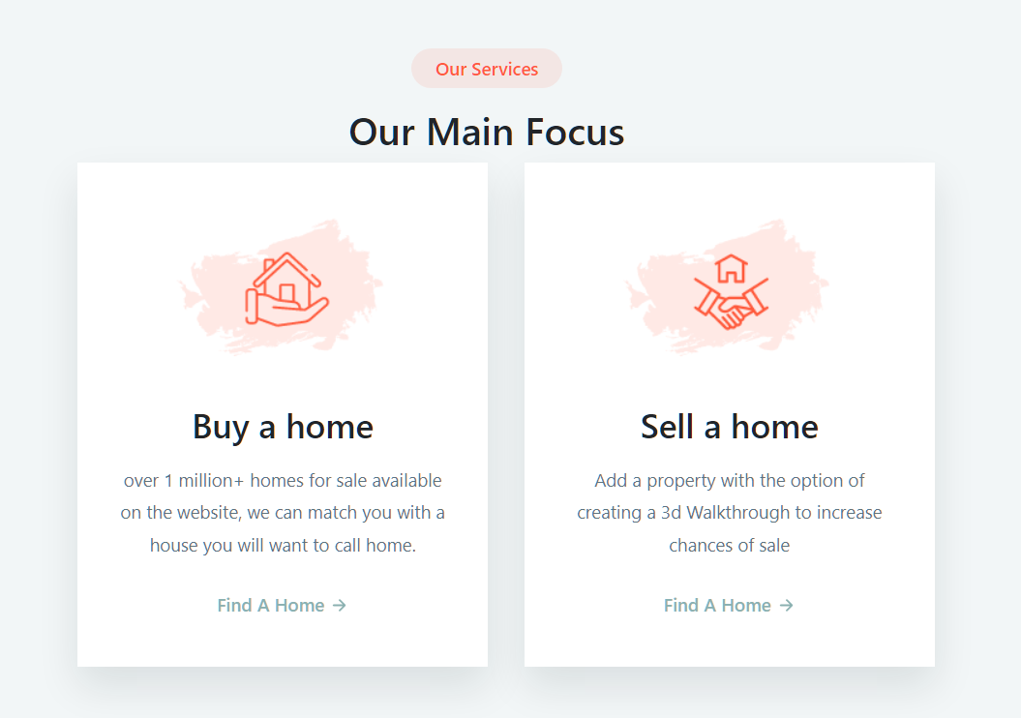
Main Focus:
Supervisor
Intro
Main

Slide 17
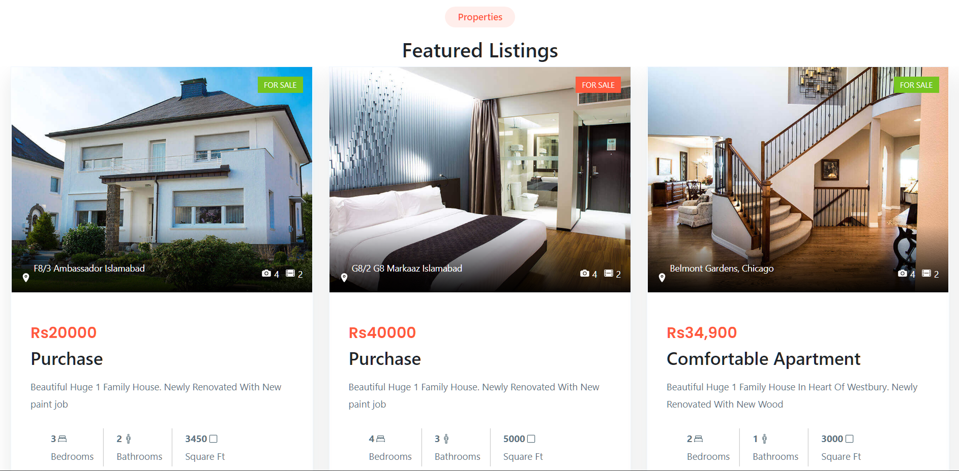
Featured listings:
Supervisor
Intro
Main

Slide 18
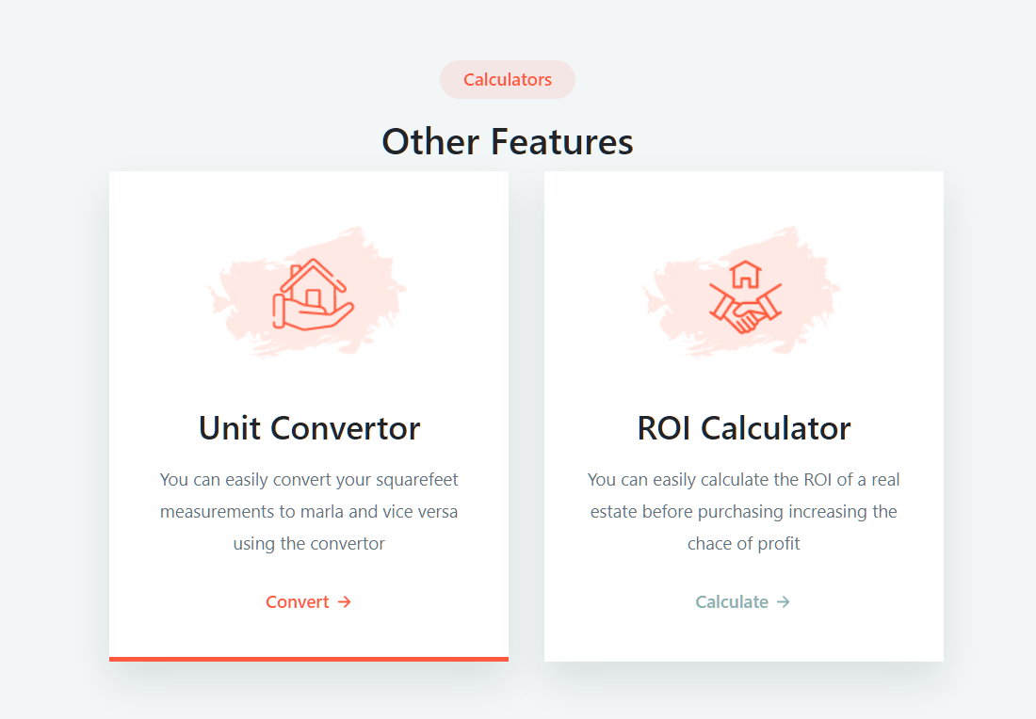
Calculators:
Supervisor
Intro
Main

Slide 19
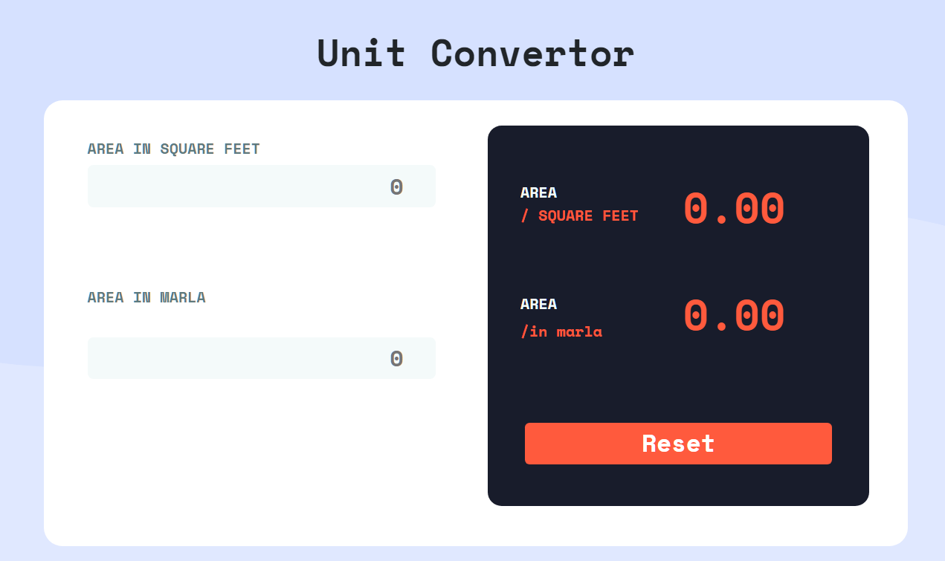
Unit Converter:
Supervisor
Intro
Main

Slide 20
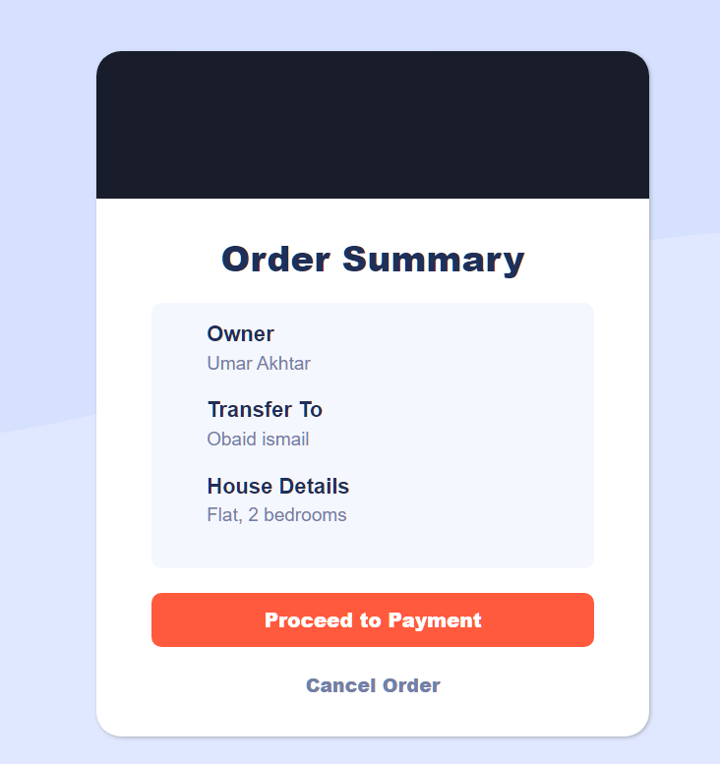
Order Summary:
Supervisor
Intro
Main

Slide 21
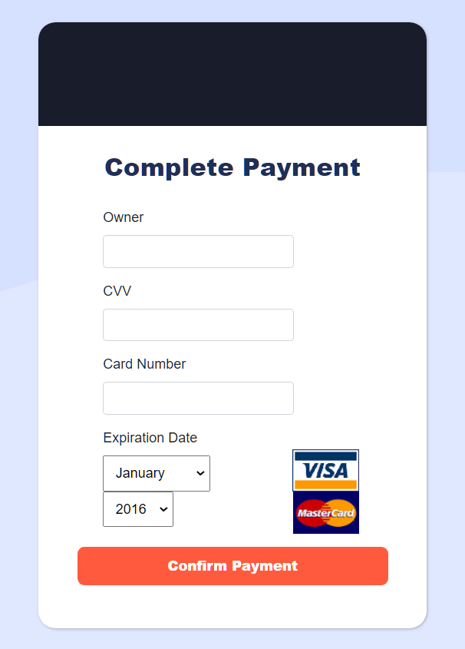
Payment Page:
Supervisor
Intro
Main

Slide 22
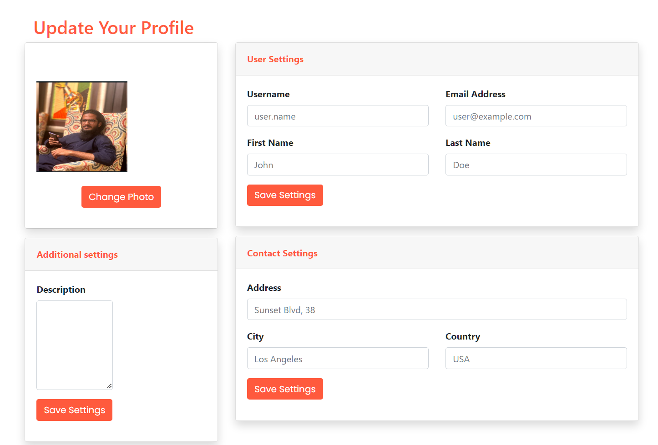
Update Profile:
Supervisor
Intro
Main

Slide 23
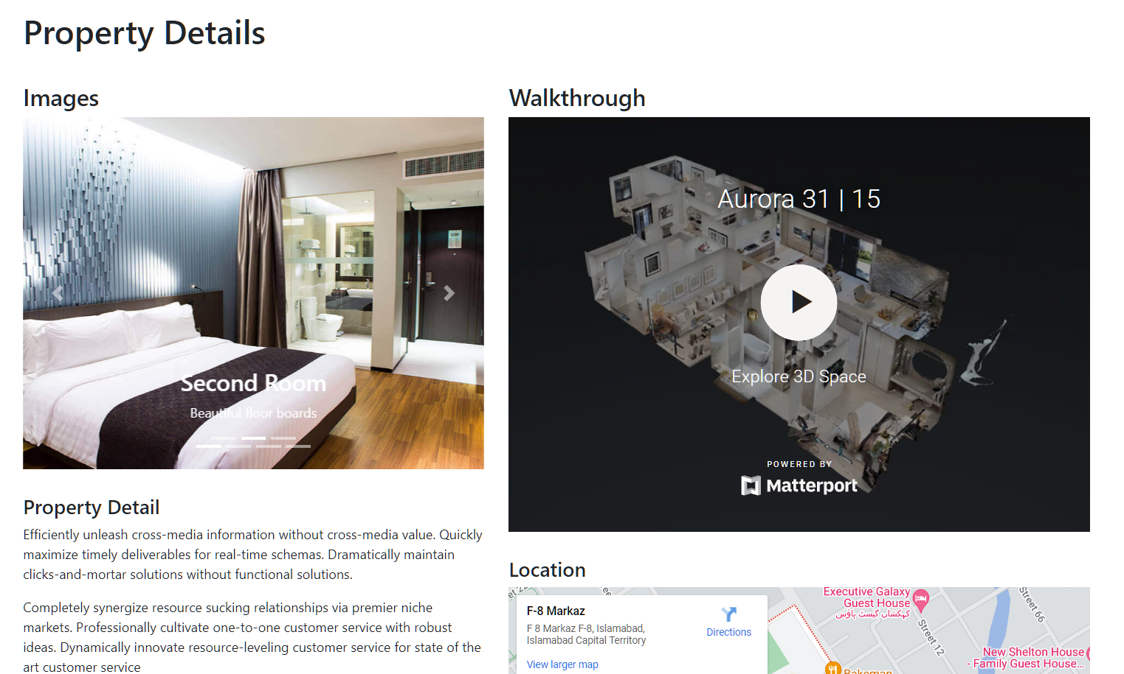
View property:
Supervisor
Intro
Main

Slide 24
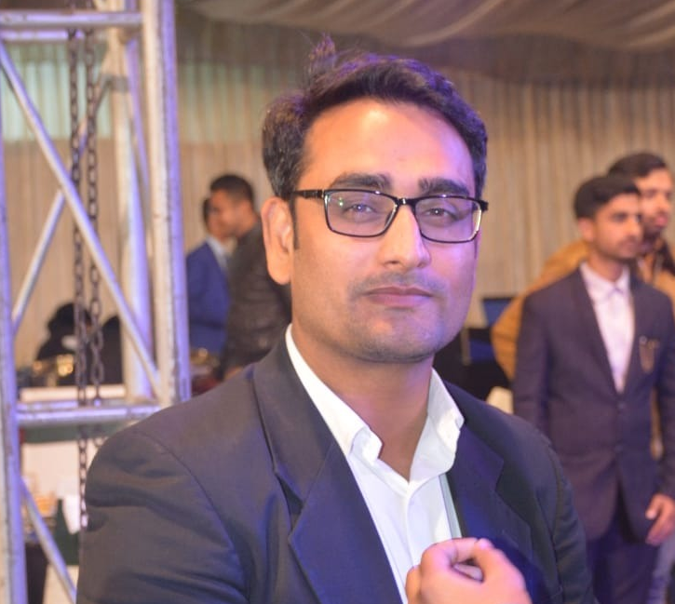
E-State
Intro
Supervisor
Main
Hafiz Muhammad
Ahsan Shehzad

Slide 25

Intro
Supervisor
Main

